Slide 1
Capstone Project Hotel Booking Analysis
SAJEENA T R

Slide 2
Points for discussion
Business Objective
Data Summary
Data inspection
Data cleaning
Explaratory data Analysis
Data visualization
Conclusion

Slide 3
Business Objective
This data set contains booking information for a city hotel and a resort hotel,
includes information such as when the booking was made, length of stay, the number of adults, children, and/or babies
The project aims to gain the interesting insight into the different factors that affect the booking patterns and cancellations and to take measures to enhance the quality and customer satisfaction, thus by increasing the revenue.

Slide 4
Data Summary
The dataset contains 119390 rows and 32 columns
The dataset contains 31994 duplicate values.
Total number of null values in the dataset is 87396.
The columns children contains 4, country contains 452, agent contains 12193 and company contains 82137.
adr column contains outlier

Slide 5
Data Summary Variables
stays_in_weekend_nights: Number of weekend nights (Saturday or Sunday) spent at the hotel by the guests.
stays_in_week_nights: Number of weeknights (Monday to Friday) spent at the hotel by the guests.
adults: Number of adults among guests.
children: Number of children among guests.
babies: Number of babies among guests.
meal: Type of meal booked.
country: Country of guests. 15.market_segment: Designation of market segment.
hotel: Name of the hotel (Resort Hotel or City
Hotel).
is_canceled: If the booking was canceled (1) or not (0).
lead_time: Number of days before the actual arrival of the guests.
arrival_date_year: Year of arrival date.
arrival_date_month: Month of arrival date.
arrival_date_week_number: Week number of
year for arrival date.
arrival_date_day_of_month: Day of month for arrival date.

Slide 6
Data Summary
distribution_channel: Name of booking distribution channel.
is_repeated_guest: If the booking was from a
repeated guest (1) or not (0).
previous_cancellations: Number of previous bookings that were cancelled by the customer prior to the current booking.
previous_bookings_not_canceled: Number of previous bookings not cancelled by the
customer prior to the current booking.
reserved_room_type: Code of room type reserved.
21. assigned_room_type: Code of room type assigned.
booking_changes: Number of
changes/amendments made to the booking.
deposit_type: Type of the deposit made by the guest
agent: ID of travel agent who made the booking.
company: ID of the company that made the booking.
days_in_waiting_list: Number of days the
booking was in the waiting list.
customer_type: Type of customer

Slide 7
Data Summary
adr: Average Daily Rate, as defined by dividing the sum of all lodging transactions by the total number of staying nights.
required_car_parking_spaces: Number of car parking spaces required by the
customer.
total_of_special_requests: Number of special requests made by the customer.
reservation_status: Reservation status
(Canceled, Check-Out or No-Show).
reservation_status_date: Date at which the last reservation status was updated.

Slide 8
Data cleaning
Added two more columns total_people and total_stay
Converted the datatype of reservation_status date from string to datetime
Converted the datatype of children from float to int
The duplicate values are dropped . After this columns are reduced to 87396.
All the missing values are removed using the values '0' and 'others'.
Adult 0 means no booking has been happened. So we can drop those columns.
Negative value for average daily rate is not possible. So that column also dropped.
adr column with value>5000 dropped.

Slide 9
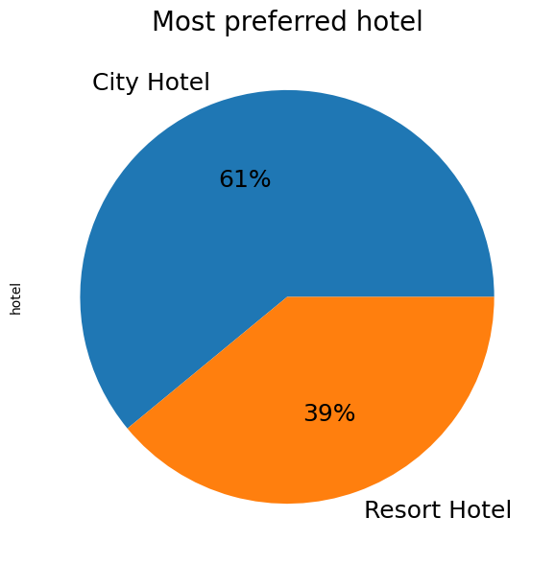
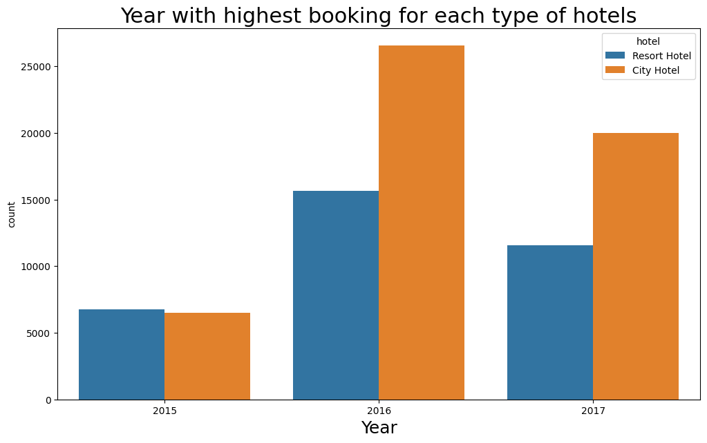
Explaratory data Analysis
Univariate analysis
City hotel is the most preferred hotel
Most bookings happened in 2016

Slide 10
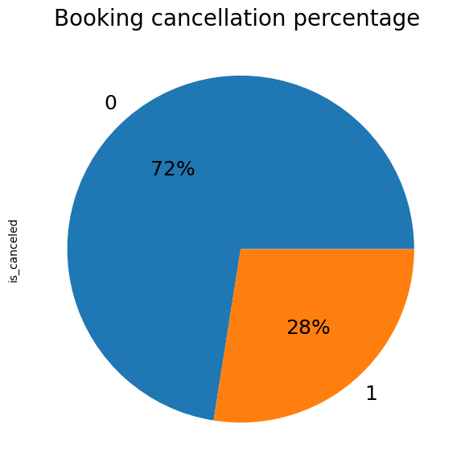
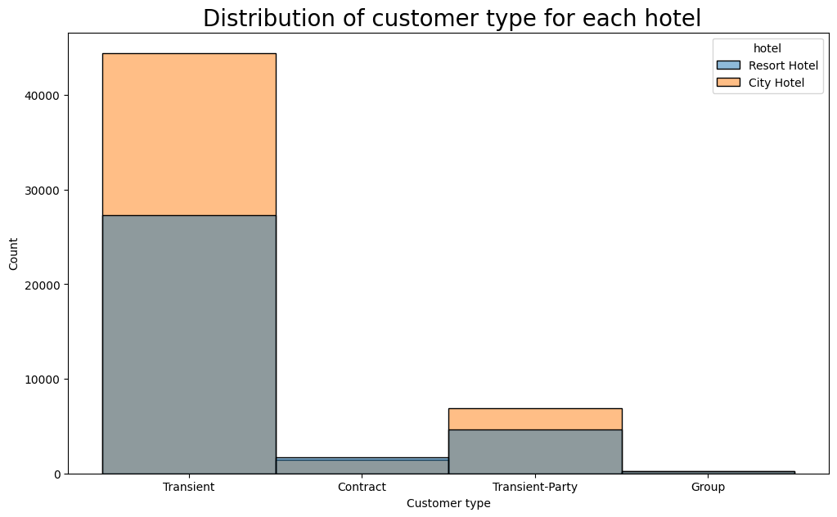
Explaratory data Analysis
Univariate analysis
Cancellation % is only 28%
Transient type customers are more

Slide 11
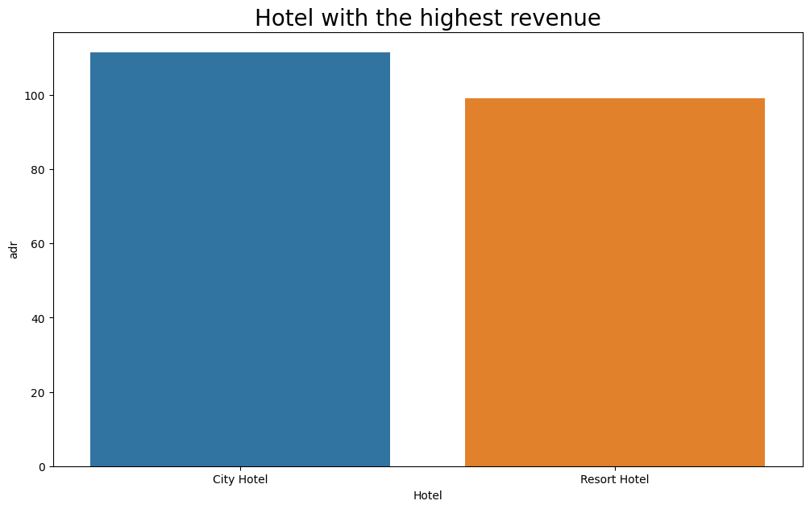
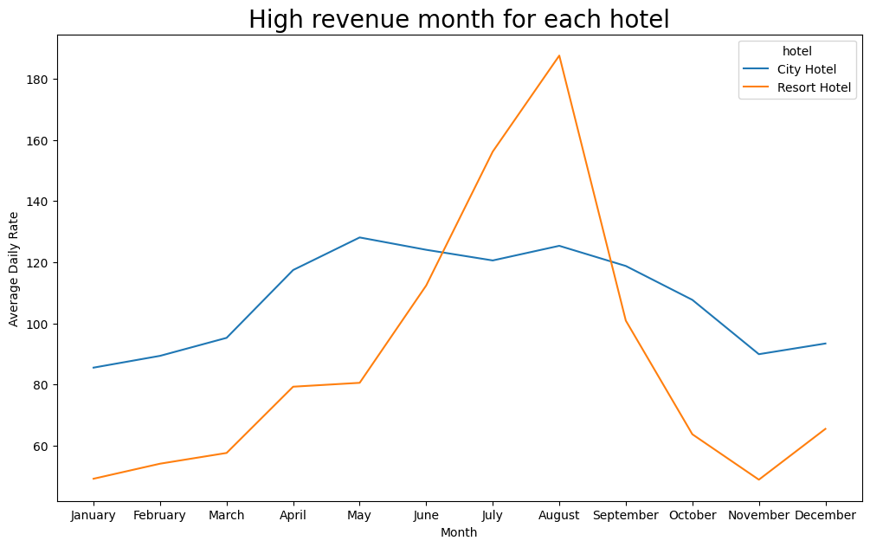
Explaratory data Analysis
Bivariate analysis
City hotel is the most revenue generated hotel.
August is the highest revenue generated month.

Slide 12
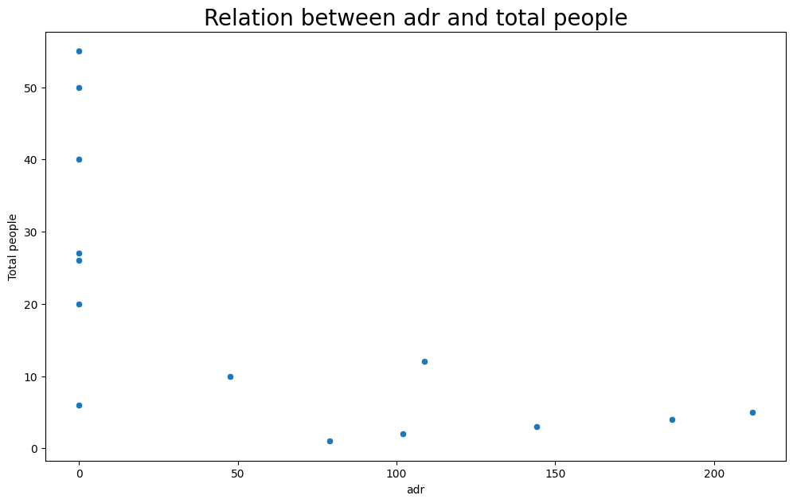
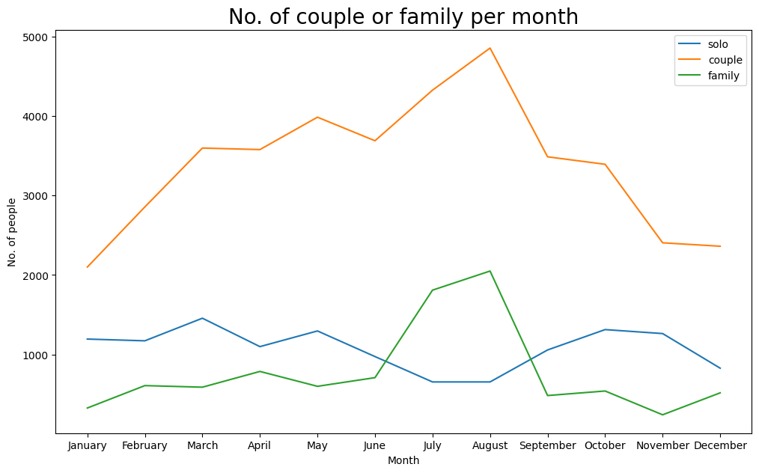
Explaratory data Analysis
Bivariate analysis
As the number of people increases the adr also increases.
Most number of couple and family visited in August.

Slide 13
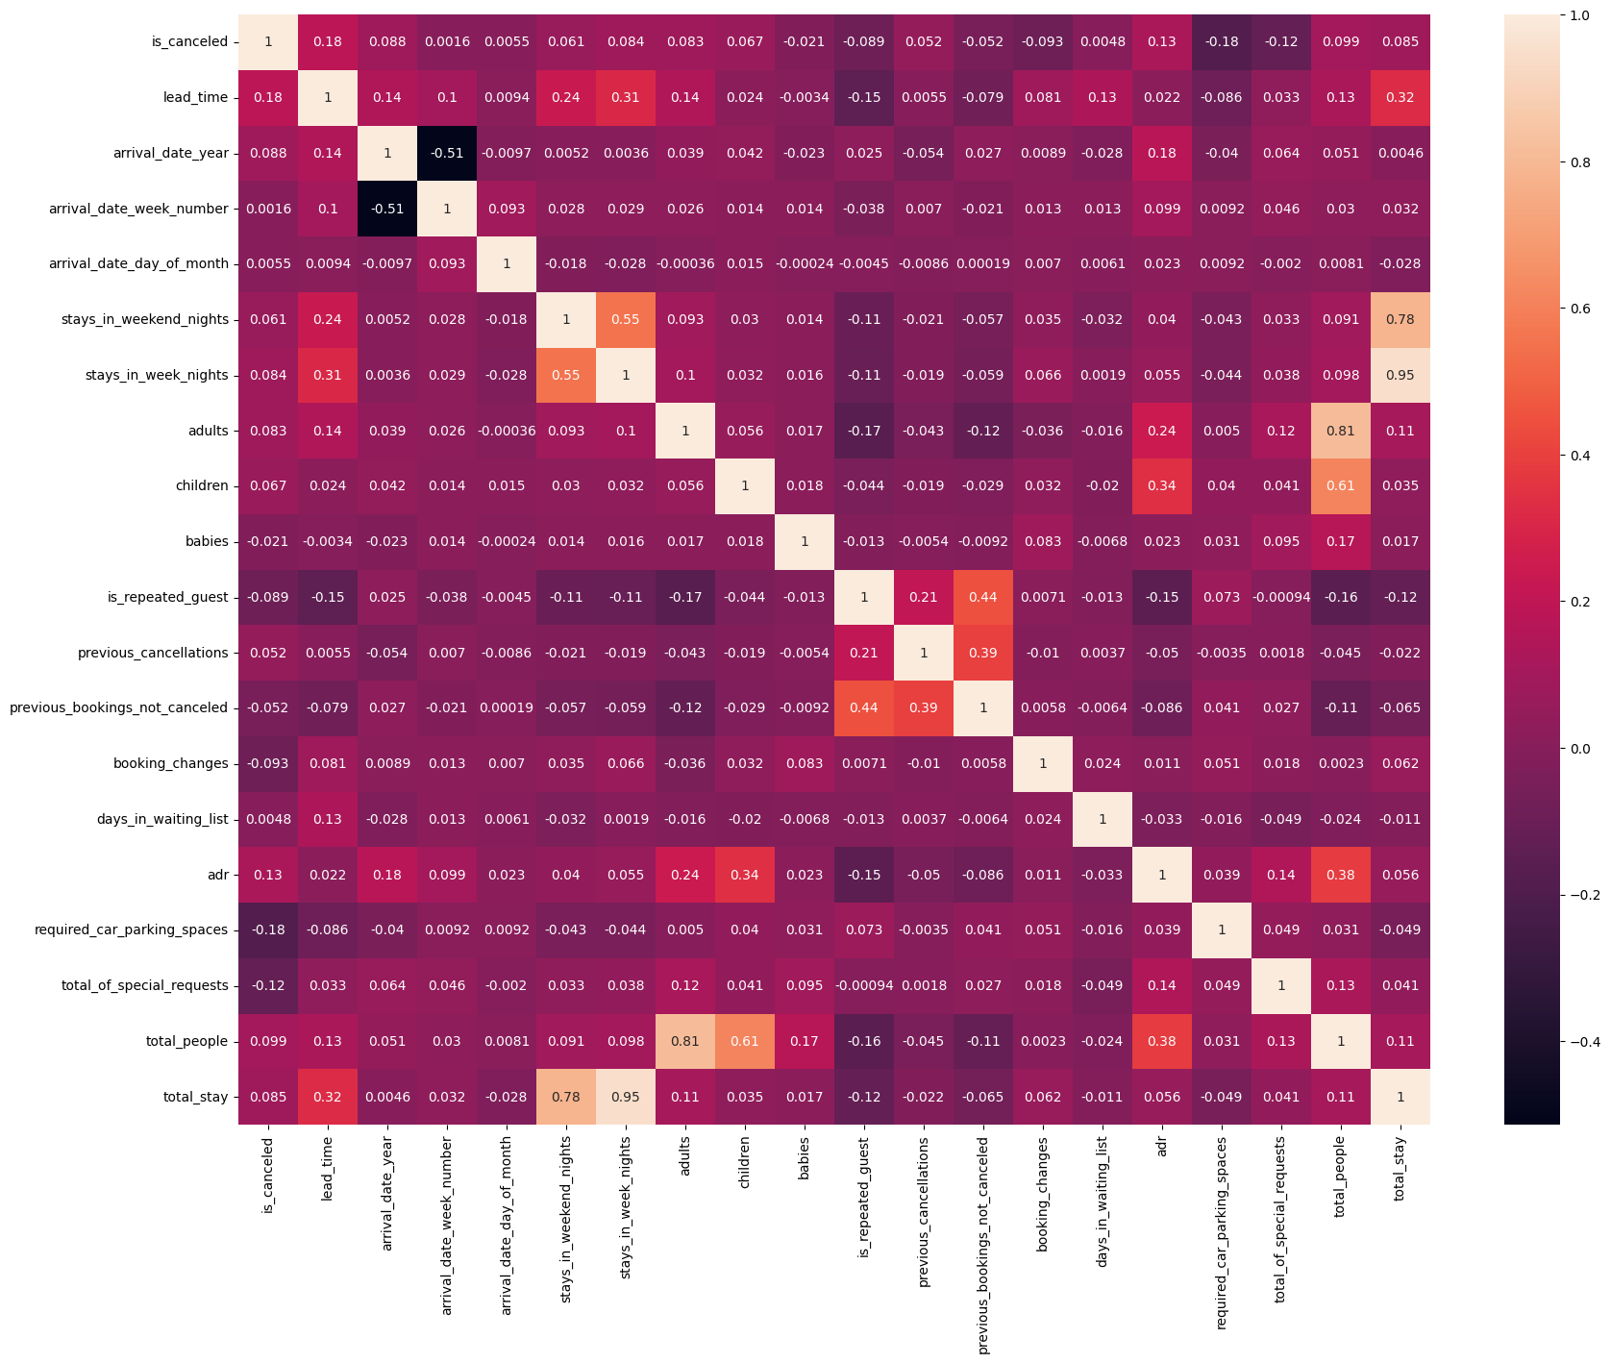
Explaratory data Analysis
Multivariate analysis
There is a positive corelation between is_canceled and days_in_waitinglist.if the number of days in waiting list is more there is a chance of cancellation.
Also a strong negative relation between totalof_special_requests and is_repeated guests.Special request guests are not choosing the same hotel again.

Slide 14
Conclusion
96% customers new customers. Only 4% is the repeated customers.
Most customers preferred the 'A' type room.
Most customers got the 'A' type room.
Most number of bookings are done through the GDS distribution channel.So the most income generated distribution channel is GDS.
Higher revenue generated hotel is city, compared to resort hotel.
Most profittable month for Resort hotel is August and for city hotel is May and August.
Resort hotel has higher lead time comapared to city hotel.
Most number of booking cancellations are in city hotels.
Most number of cancellations take place in the month of August.
Repeated customers mostly prefer the resort hotels.
Most revenue generated market segment is Online TA.
City hotel is busier than resort hotel.
Most people stayed not more than 3 days.
When the number of people increases the adr also increases.
In the month of August most customers are couples. In July and August most of the customers are family.
There is a positive corelation between is_canceled and days_in_waitinglist.
61% customers preferred city hotels. 39% customers preferred resort hotels.
August and July are the most income generating months. January, November and December are the slowest months for both hotels
Highest number of bookings are made in the year 2016.Least number of bookings are done in 2015.
Most income generating agent is 9 followed by 240 and 0.
Most preferred meal type is BB(Bed & Breakfast)
72% customers not cancelled the booking.28% customers cancelled the bookings.
Majority of the customers are Transient, followed by Transient-Party for both city and resort hotels.Minority is the customers in Group.
Majority of the customers from Portugal.

Slide 15


